Slide 1
Micro Credit Defaulter
PREDICTION
Report Summary
Submitted by:
SANTOSH H. HULBUTTI
Intern @ Flip Robo Technologies

Slide 2
The Problem Statement
This project was real time problem for Microfinance Institution (MFI), and to the poor families in remote areas with low income, MFI to provide micro-credit on mobile balances to be paid back in 5 days. The Consumer is believed to be defaulter if he deviates from the path of paying back the loaned amount within the time duration of 5 days. For the loan amount of 5 (in Indonesian Rupiah), payback amount should be 6 (in Indonesian Rupiah), while, for the loan amount of 10 (in Indonesian Rupiah), the payback amount should be 12 (in Indonesian Rupiah).
It is required to build a classification model using Machine Learning in order to predict customer who might be defaulter based on the data provided.

Slide 3
Feature Terminology
Feature Name | Meaning
Label | Flag indicating whether the user paid back the credit amount within 5 days of issuing the loan {1: non-defaulter, 0: Defaulter}
Msisdn | mobile number of users
Aon | age on cellular network in days
daily_decr30 | Daily amount spent from main account, averaged over last 30 days (in Indonesian Rupiah)
daily_decr90 | Daily amount spent from main account, averaged over last 90 days (in Indonesian Rupiah)
rental30 | Average main account balance over last 30 days
rental90 | Average main account balance over last 90 days
last_rech_date_ma | Number of days till last recharge of main account
last_rech_date_da | Number of days till last recharge of data account
last_rech_amt_ma | Amount of last recharge of main account (in Indonesian Rupiah)
cnt_ma_rech30 | Number of times main account got recharged in last 30 days
fr_ma_rech30 | Frequency of main account recharged in last 30 days
sumamnt_ma_rech30 | Total amount of recharge in main account over last 30 days (in Indonesian Rupiah)
medianamnt_ma_rech30 | Median of Amount of recharges done in main account over last 30 days at user level (in Indonesian Rupiah)
medianmarechprebal30 | Median of main account balance just before recharge in last 30 days at user level (in Indonesian Rupiah)
cnt_ma_rech90 | Number of times main account got recharged in last 90 days
fr_ma_rech90 | Frequency of main account recharged in last 90 days
sumamnt_ma_rech90 | Total amount of recharge in main account over last 90 days (in Indonesian Rupee)
medianamnt_ma_rech90 | Median of Amount of recharges done in main account over last 90 days at user level (in Indonesian Rupee)
medianmarechprebal90 | Median of main account balance just before recharge in last 90 days at user level (in Indonesian Rupee)
cnt_da_rech30 | Number of times data account got recharged in last 30 days
fr_da_rech30 | Frequency of data account recharged in last 30 days
cnt_da_rech90 | Number of times data account got recharged in last 90 days
fr_da_rech90 | Frequency of data account recharged in last 90 days
cnt_loans30 | Number of loans taken by user in last 30 days
amnt_loans30 | Total amount of loans taken by user in last 30 days
maxamnt_loans30 | maximum amount of loan taken by the user in last 30 days
medianamnt_loans30 | Median of amounts of loan taken by the user in last 30 days
cnt_loans90 | Number of loans taken by user in last 90 days
amnt_loans90 | Total amount of loans taken by user in last 90 days
maxamnt_loans90 | maximum amount of loan taken by the user in last 90 days
medianamnt_loans90 | Median of amounts of loan taken by the user in last 90 days
payback30 | Average payback time in days over last 30 days
payback90 | Average payback time in days over last 90 days
Pcircle | telecom circle
Pdate | Date

Slide 4
EDA Steps & Assumptions
The input data was shared in CSV format.
There were 37 attributes (36 features and 1 target).
The target variable is either 1 or 0 which means non defaulter and defaulter respectively.
There was total 209593 rows of observations.
3 features namely, 'Unnamed: 0', 'msisdn','pdate', ‘pcircle’ were removed as they carry no value for predicting defaulter/non-Defaulter.
Statistical techniques used:
Skewness check using ‘.skew()’ method & removing using power transformation method,
Outliers’ removal using ‘Z-Score’ method (3 Std deviation method),
Correlation check using ‘.corr()’ & heatmap method,
Minimizing Multi collinearity using ‘Variance Inflation Factor(VIF)’,
Scaling input data using ‘StandardScaler()’ method,
Removing data imbalance using ‘SMOTE’ method,
Graphical modelling done through seaborn, matplotlib, Tableau, sweetviz & Autoviz.
There were 2089 observations which were having unrealistic entry of age on network(more than 65 years) & 2503 observations which were having age less than 60 days, as there were some columns which were having 30 & 90 day simple moving period average having the consisting data with moving average entries was better. also new customers cannot be assessed with no usage history. so, it was considered to create model based on the people who had at least 60 days of usage history & less than 65 years using cellular network.
Some features were dropped as the entries did not have any meaning with respect to target variable.
Total data loss in pre-processing was 4%.
Data imbalance was dealt with using SMOTE method.

Slide 5
Visualizations
Plots used for Data Visualization:
Distribution plots
Pie chart
Histogram
Scatter plots
Count plots
Box Plot
Bar plots
Heatmaps

Slide 6
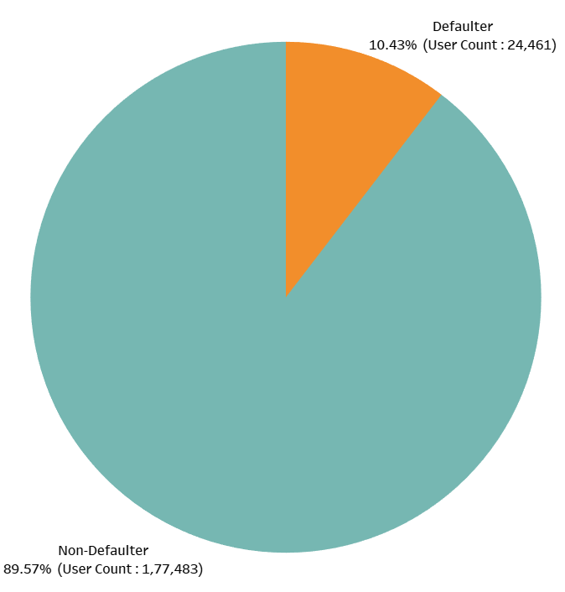
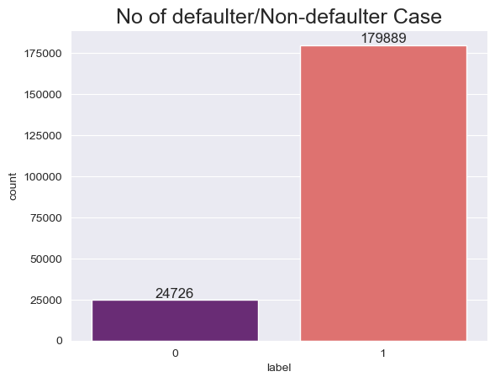
Target variable
From Cleaned data
From input un-cleaned data
We see that input data was highly imbalanced and more than 89% of the observations were non-defaulters. The data was balanced before feeding it to ML models using SMOTE.

Slide 7
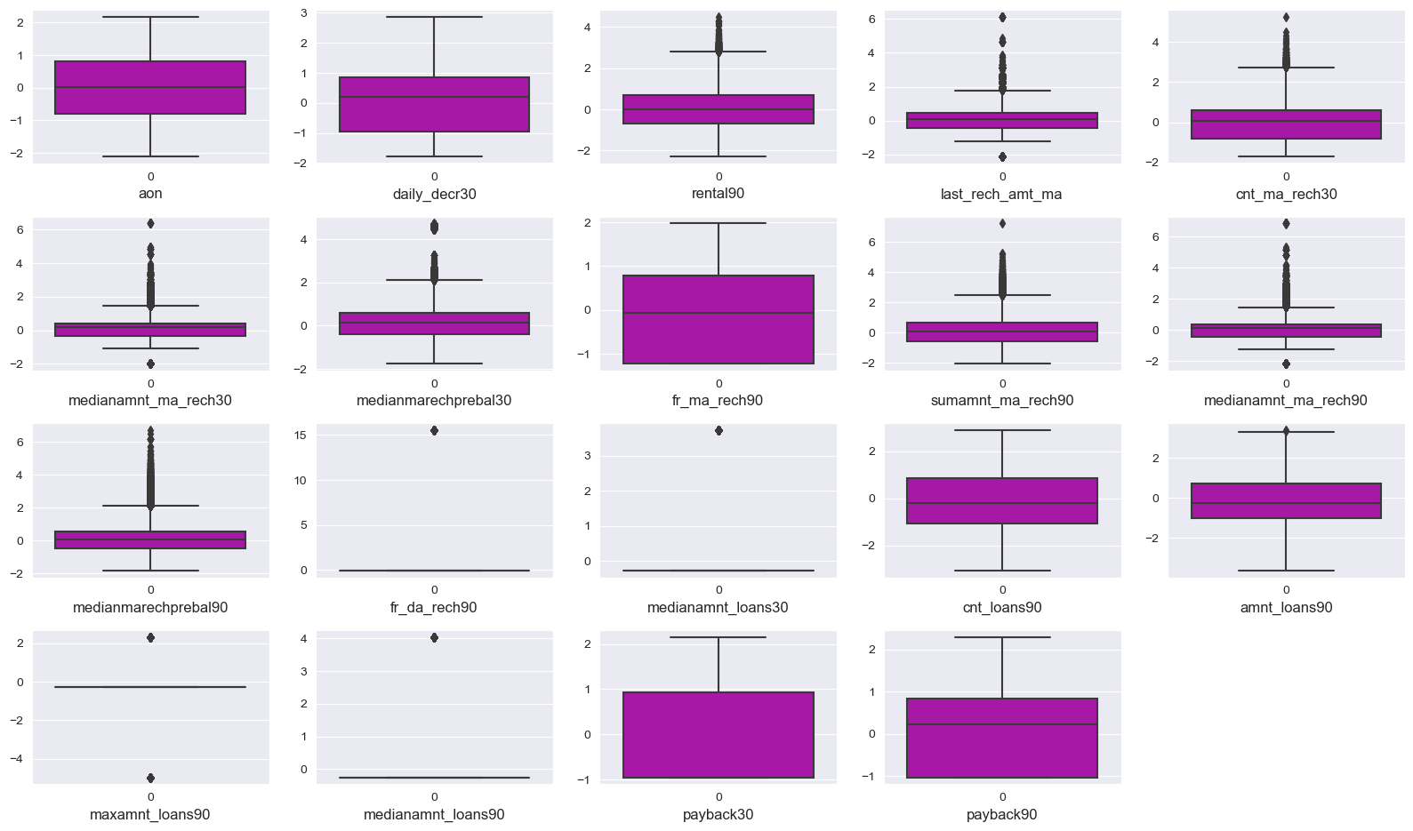
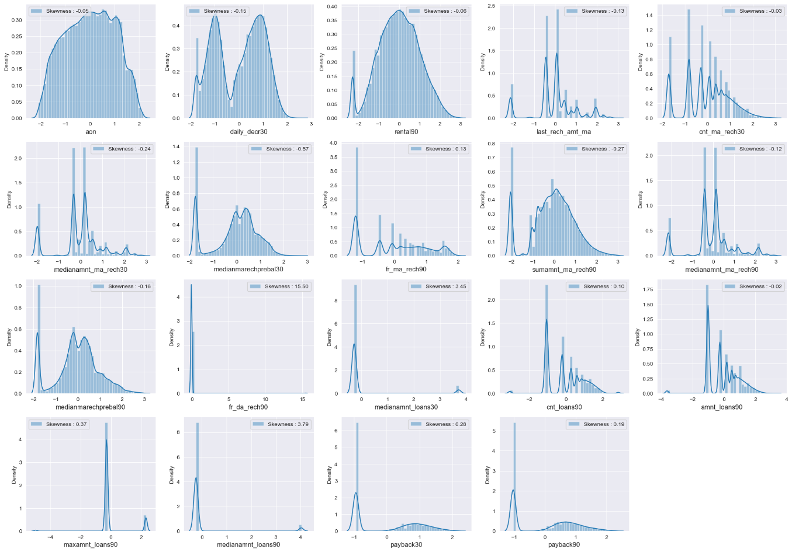
Independent Features
The cleaned data showed some features having normal distribution, & some with high right skewness. Some features were discrete numbers
Some of the features were highly skewed due to presence of 0 entries, outliers were also present.

Slide 8
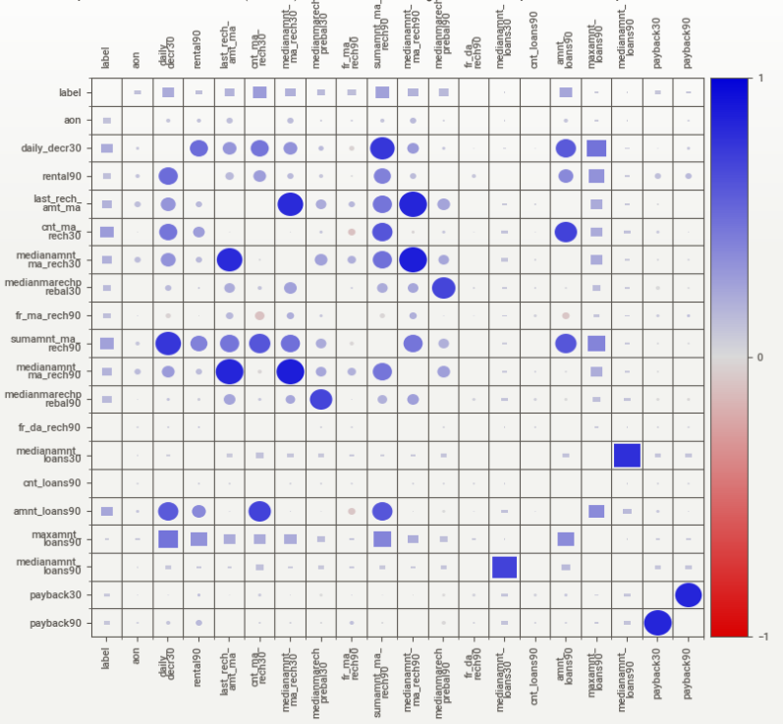
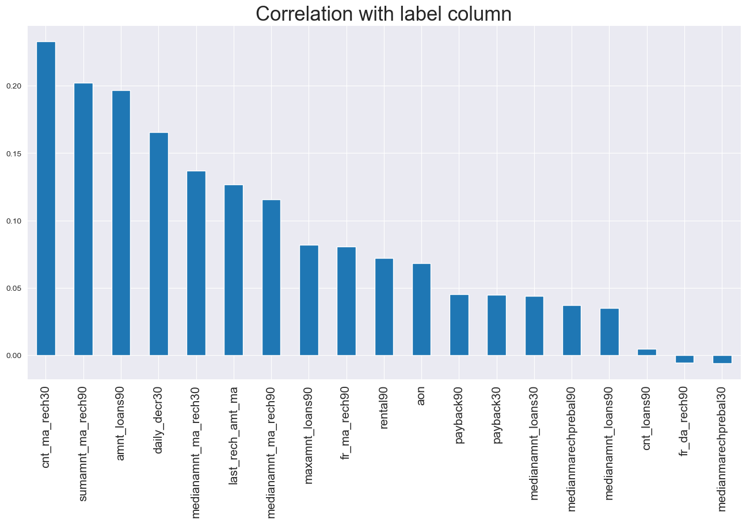
Bivariate Analysis
All features were showing positive correlation with target variable.

Slide 9
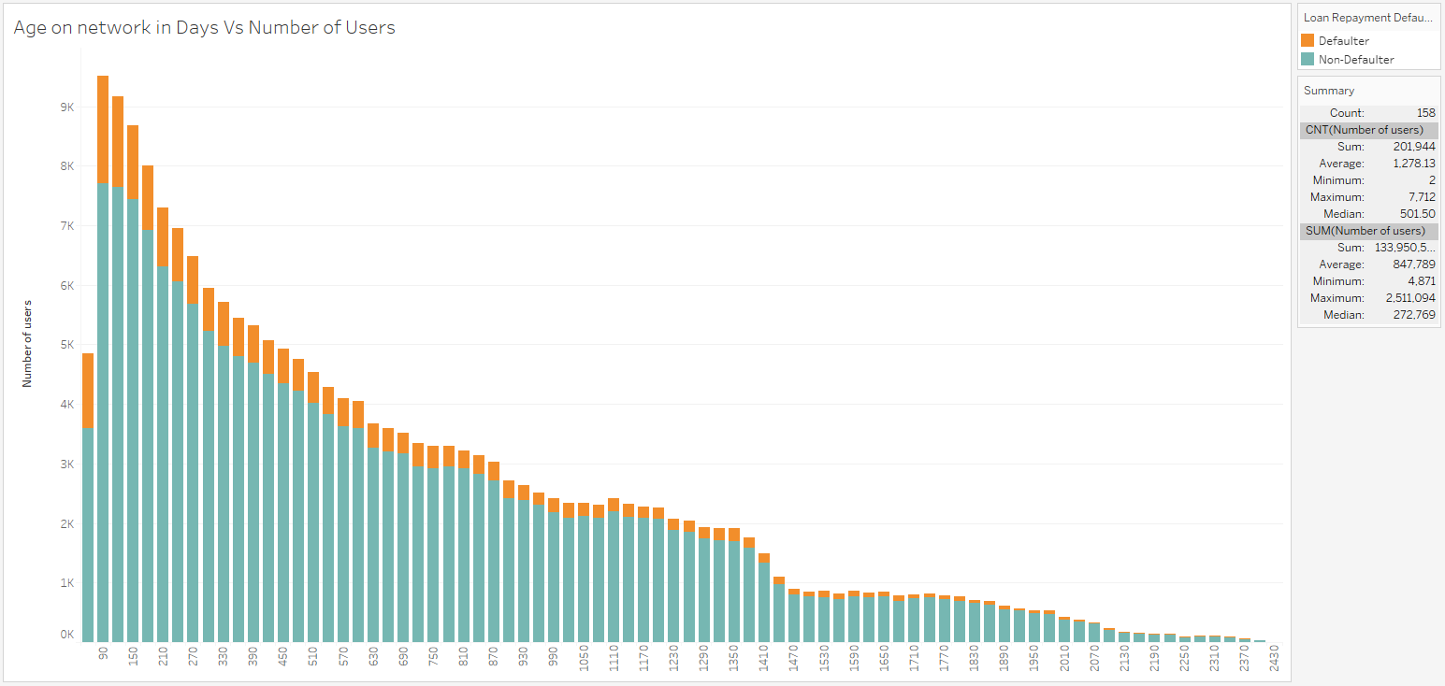
Bivariate Analysis
Higher the age on network less are the chances of being a defaulter.
Most of the users were new users on the network.

Slide 10
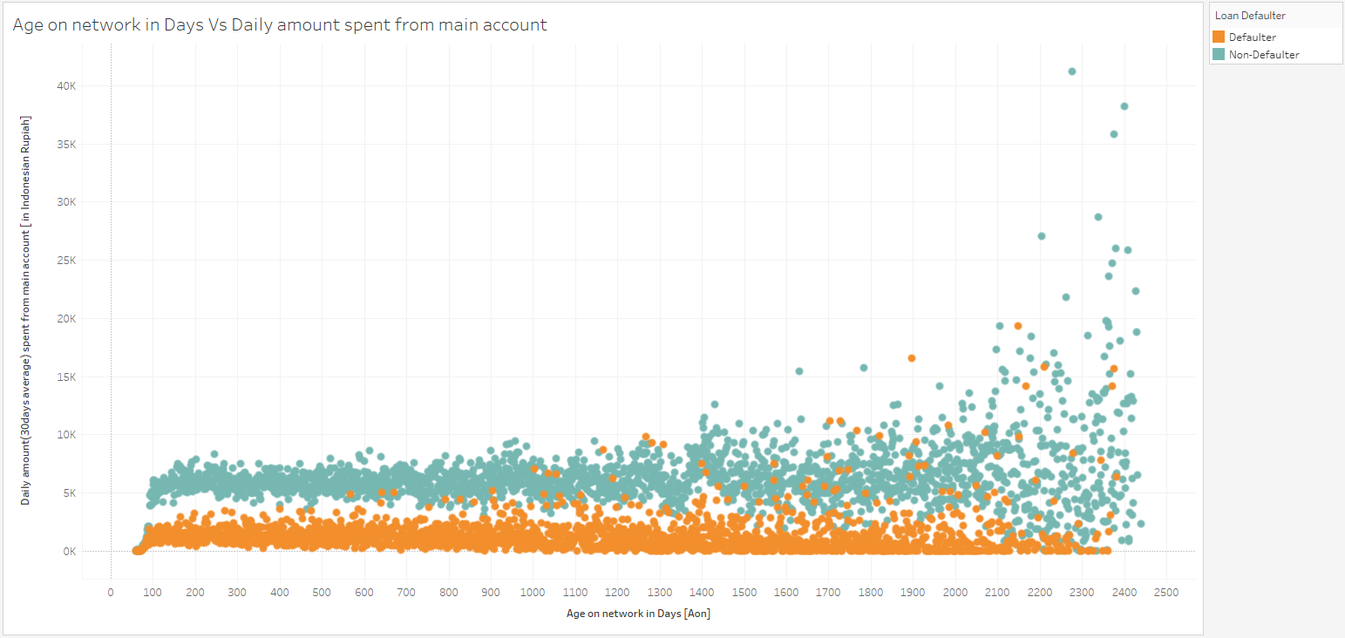
Bivariate Analysis
Those users spending more than 3000 Rupiah from main account are unlikely to be defaulter.

Slide 11
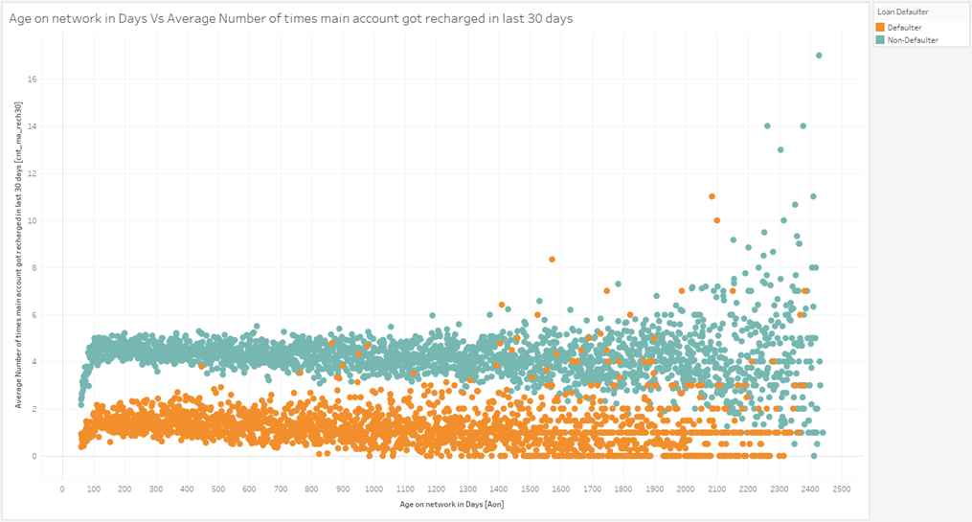
Bivariate Analysis
Users recharging their main more than 2-3 times in a month are unlikely to be a defaulter.

Slide 12
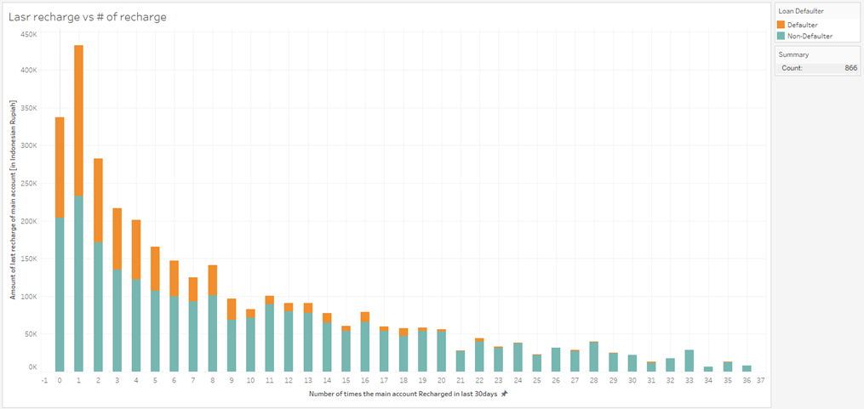

Bivariate Analysis
Out of Users recharging their main account with more than 100K Rupiah & recharge less than 10 times in a month, more than 35% users will default their loan payment.

Slide 13
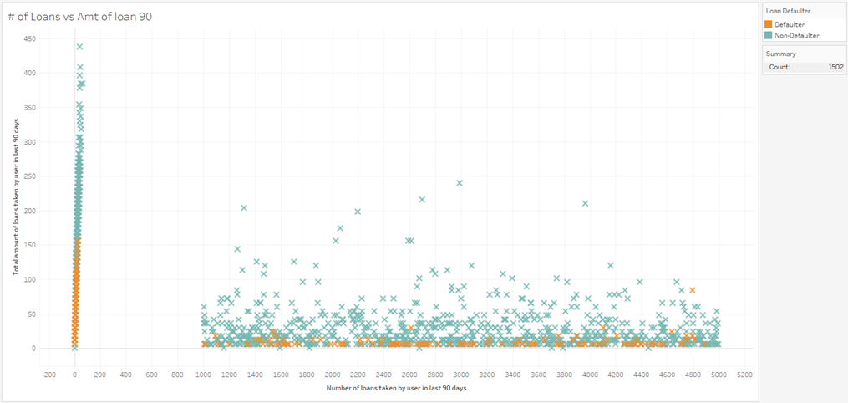
Bivariate Analysis
Those users with total number of loan taken more than 1000 times in last 3 months are unlikely to be a defaulter. Also those users who exceed the total amount of loan more than 150 rupias are likely to pay back.

Slide 14
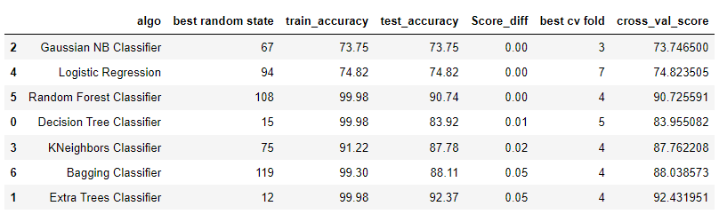
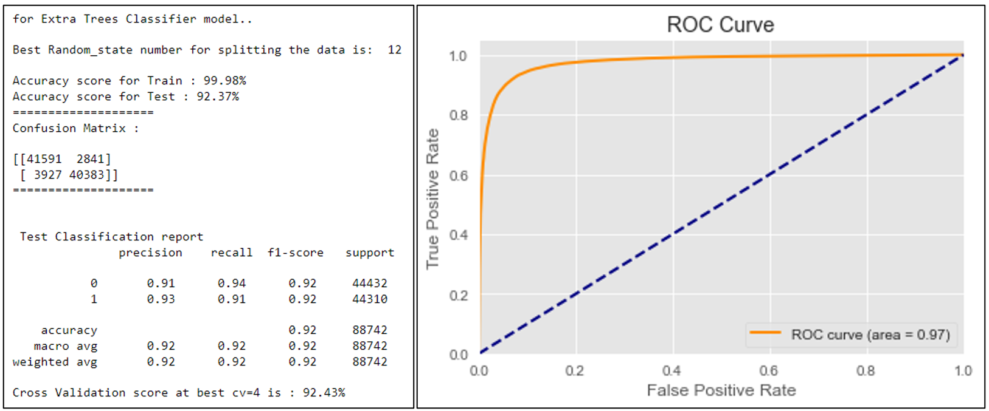
Finalized Model
We selected Extra Trees Classifier for the following reasons:
High Testing & Cross validation score among all the models.
Highest area under AUC ROC Curve.

Slide 15
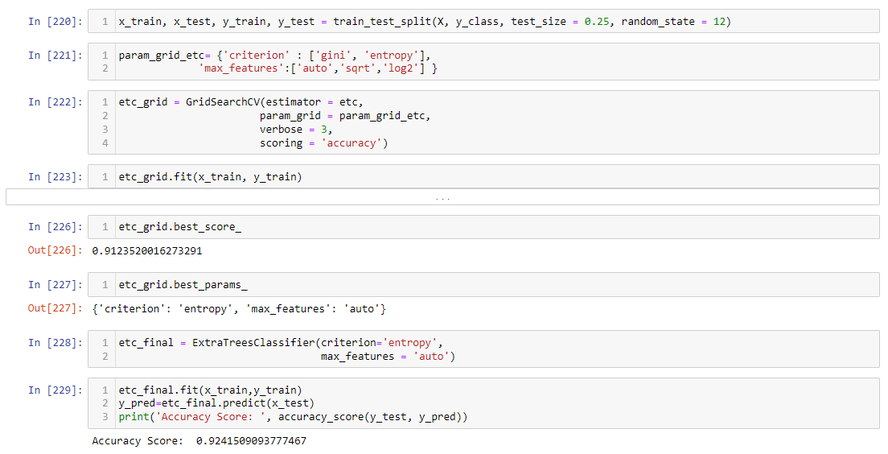
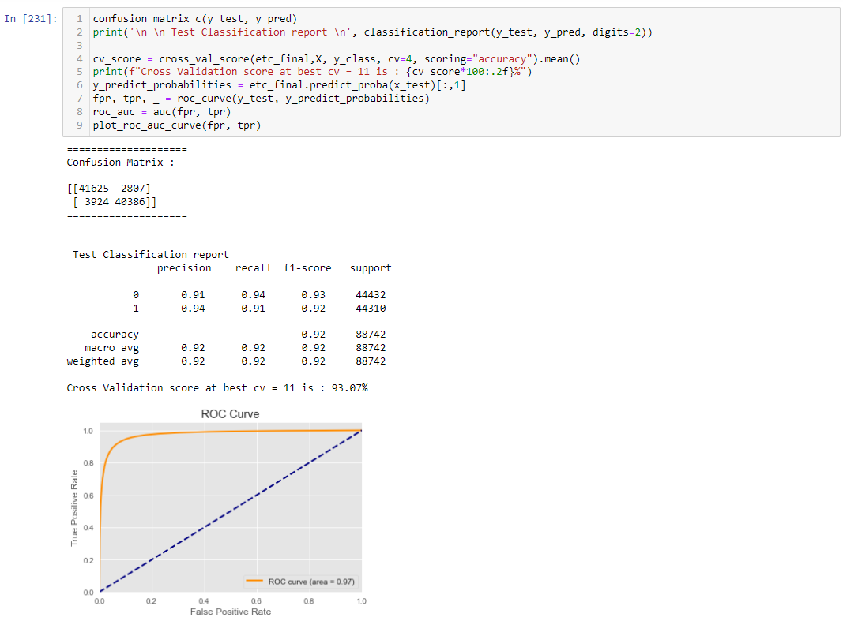
Finalized Model
After Selecting th ML model, We ran Grid Search CV to find out best hyperparameter for our model to increase accuracy/performance of our model.
We can see from the images that our accuracy Score & Cross validation scores are increased after tuning the hyperparameters.

Slide 16
Conclusion
Outcome of this project is a Machine Learning model which can whether a user will default or not if he given a micro credit loan.
This model has accuracy of the prediction of 92.41%. It will help companies to give loans to those users who are likely to payback the loan amount with interest within stipulated time period.
Higher the age on network less are the chances of being a defaulter.
Those users spending more than 3000 Rupiah from main account are unlikely to be defaulter.
Most of the users used to recharge their main account maximum of 1-9 times in last 30 days. Those recharging more than 2-3 times were unlikely to be a defaulter.
If age on network is more than 1500 days, it was more likely that users spending more money from main account & being non-defaulters.
Those users with total number of loans taken more than 1000 times in last 3 months are unlikely to be a defaulter. Also, those users who exceed the total amount of loan more than 150 rupias are likely to pay back.
Out of Users recharging their main account with more than 100K Rupiah & recharge less than 10 times in a month, more than 35% users will default their loan payment.
Most of the users paid back within 3 days, so people who didn't return the money till 10 days are most likely to be defaulters.

